Slide 1
Draft of Dashboard
2 options for dashboard

Slide 2
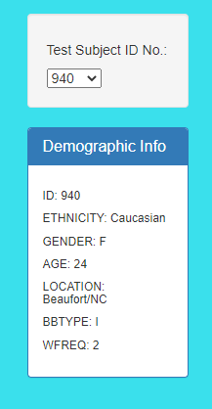
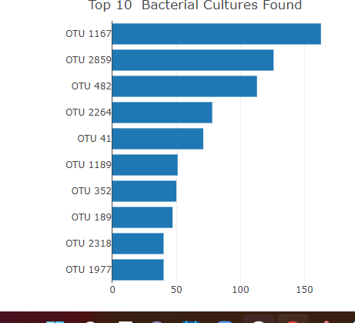
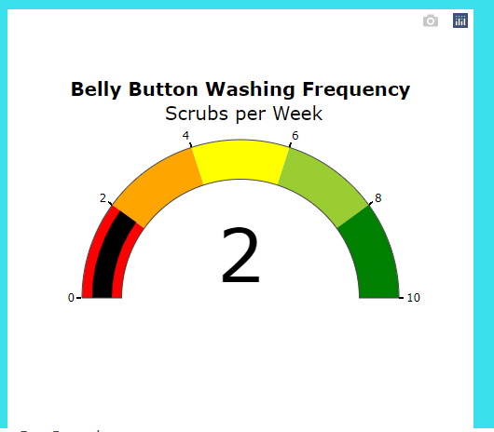
Option 1: HTML page similar to Plotly Belly button
Cuisine
info
Title and image of page
Machine learning image
Map of restaurants
Rating gauge
Top rated restaurants

Slide 3
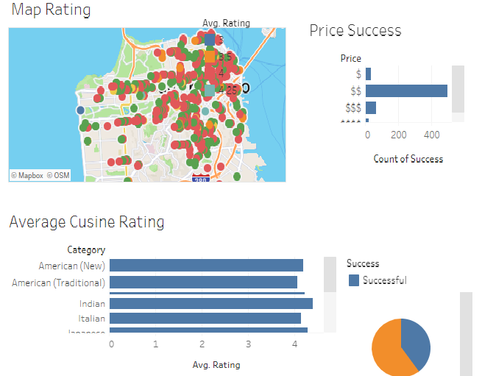
Option 2: Tableau Dashboards

